Slide 1
WEBMONK (COURSE DAY - 10)
Topics covered:
* what is database & its types?
* SQL vs NOSQL
* More on NOSQL
* MongoDB basics

Slide 2
DATABASE & ITS TYPES

Slide 3
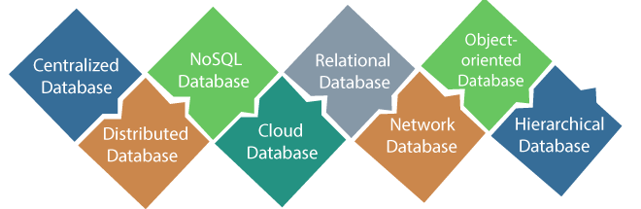
DATABASE & ITS TYPES
a database is an organized collection of structured information, or data, typically stored electronically in a computer system. A database is usually controlled by a database management system (DBMS). Together, the data and the DBMS, along with the applications that are associated with them, are referred to as a database system, often shortened to just database.

Slide 4
SQL VS NOSQL

Slide 5
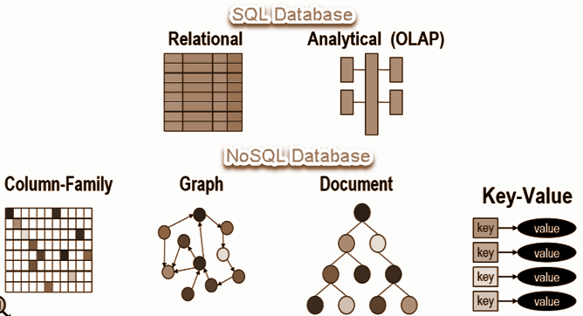
SQL VS NOSQL
* SQL databases are relational, NoSQL are non-relational.
* SQL databases use structured query language and have a predefined schema. NoSQL databases have dynamic schemas for unstructured data.
* SQL databases are vertically scalable, NoSQL databases are horizontally scalable.
* SQL databases are table based, while NoSQL databases are document, key-value, graph or wide-column stores.
* SQL databases are better for multi-row transactions, NoSQL are better for unstructured data like documents or JSON.

Slide 6
MORE ON NOSQL

Slide 7
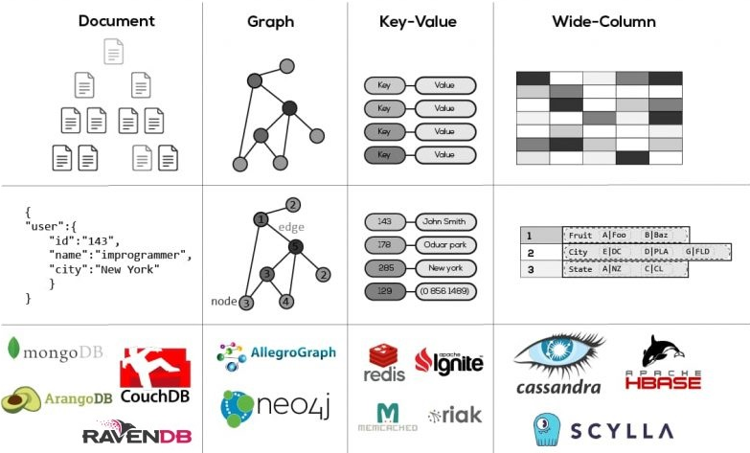
MORE ON NOSQL
* NoSQL databases (aka "not only SQL") are non tabular, and store data differently than relational tables. NoSQL databases come in a variety of types based on their data model. They provide flexible schemas and scale easily with large amounts of data and high user loads.
* NoSQL data models allow related data to be nested within a single data structure.
* NoSQL databases emerged in the late 2000s as the cost of storage dramatically decreased. Gone were the days of needing to create a complex, difficult-to-manage data model simply for the purposes of reducing data duplication. Developers (rather than storage) were becoming the primary cost of software development, so NoSQL databases optimized for developer productivity.

Slide 8
MONGODB BASICS

Slide 9
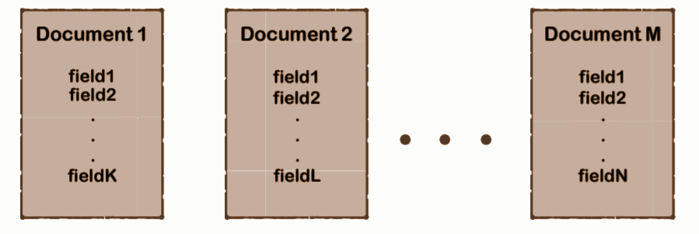
WHAT IS MONGODB?
* MongoDB is a cross-platform document-oriented database program.
* Classified as a NoSQL database program, MongoDB uses JSON-like documents with optional schemas.

Slide 10
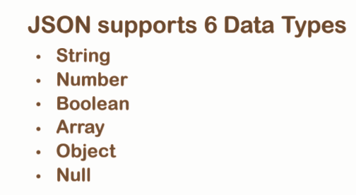
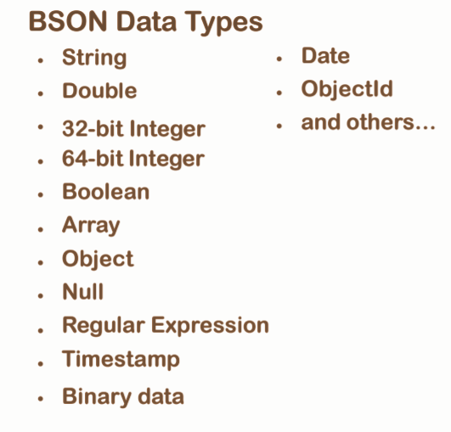
JSON VS BSON
* JSON a.k.a JavaScript Object Notation is an open standard file format, and data interchange format, that uses human-readable text to store and transmit data objects consisting of attribute–value pairs and array data types.
* BSON is a computer data interchange format. The name "BSON" is based on the term JSON and stands for "Binary JSON". It is a binary form for representing simple or complex data structures including associative arrays, integer indexed arrays, and a suite of fundamental scalar types. BSON originated in 2009 at MongoDB.

Slide 11
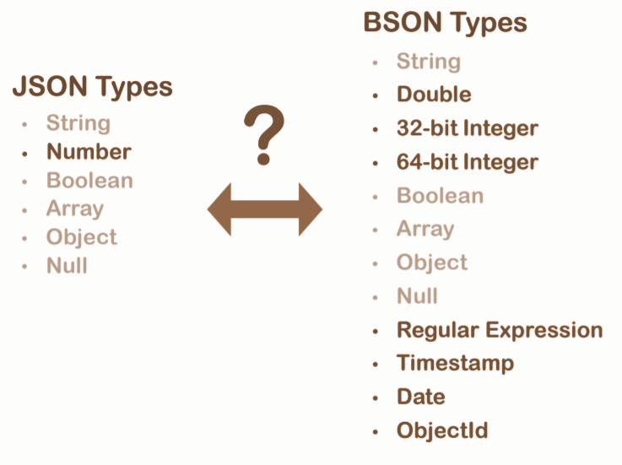
CONVERSION

Slide 12
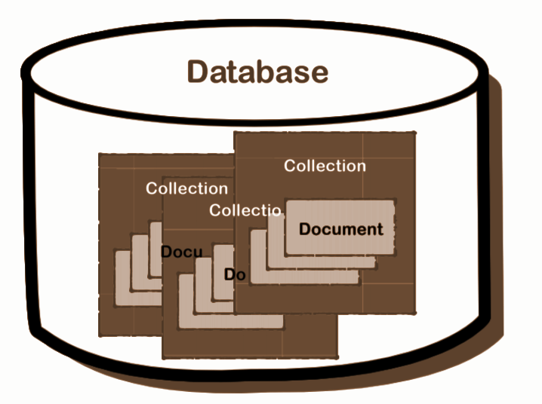
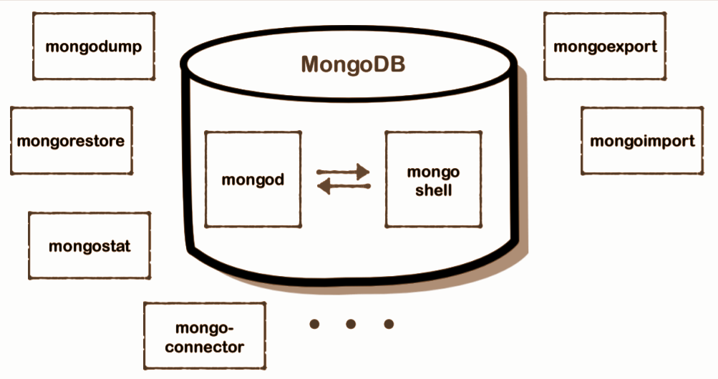
MONGO STRUCTURE & ARCHITECTURE

Slide 13
SOME CRUD WITH MONGODB**

Slide 14
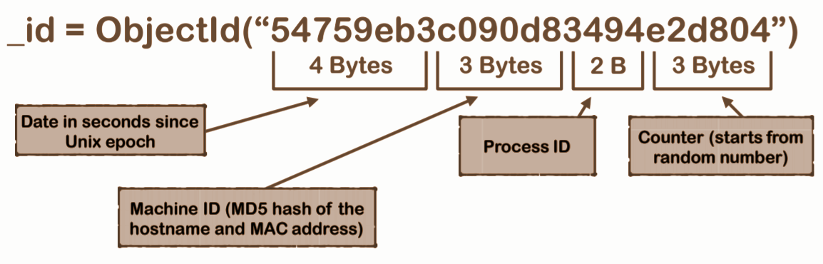
WHAT IS _id?
* Mandatory document field.
* Can be assigned manually.
* Will be created automatically if not assigned manually (recommended)

Slide 15
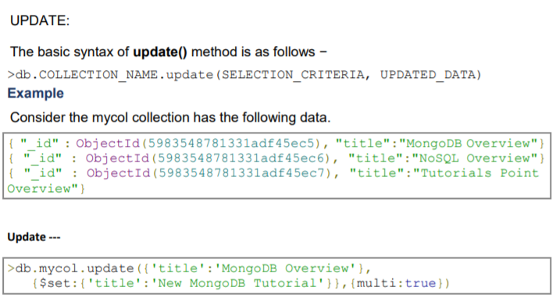
UPDATE

Slide 16
SKIP & LIMIT
The Limit() Method
To limit the records in MongoDB, you need to use limit() method. The method accepts one number type argument, which is the number of documents that you want to be displayed.
The basic syntax of limit() method is as follows −
> db.COLLECTION_NAME.find().limit(NUMBER)
> db.mycol.find({},{"title":1,_id:0}).limit(2)
If you don't specify the number argument in limit() method then it will display all documents from the collection.
MongoDB Skip() Method
Apart from limit() method, there is one more method skip() which also accepts number type argument and is used to skip the number of documents.
The basic syntax of skip() method is as follows −
>db.COLLECTION_NAME.find().limit(NUMBER).skip(NUMBER)
>db.mycol.find({},{"title":1,_id:0}).limit(1).skip(1)

